Slide 1









ENGLISH PREMIUM LEAGUE
Analysis across 20 seasons.
DNSC 6305_80
DR ALI OBAIDI
DEC9, 2022
GROUP 12

Slide 2





ASK 1
Data Set Description:
English Premier League data points from 1997/1998 season up to 2017/2018 season.
Information Covered: details about seasons, team fixtures, attributes such as such as goals scored, corners conceded, yellow cards etc.
Data consists of 335,160 records and 14 columns in a table
Source of data: Dataset is from data.world/ Updated by Ahmed Oyelowo. The dataset itself is derived from official data released the by Premier League.

Slide 3


Why this data and what appeals to you?
For better decision making and assessment with regards to the effects of various attributes on the end result.
It helps club coaches and administrators to explore the effect of shot locations.
Suitable for dimensional modeling and analytical analysis and provided the records with detailed description.
Highlights the pain points in the respective teams across the seasons with clear records and reasonable dimensions.

Slide 4




What Analytical Questions Will We Answer Using The Dataset?
Business Question 1:
What is the best performing team with highest score across the seasons between 2007|2008 and 2017|2018? What strategy earns more points-'Attack’ vs ‘Defense’ attributes.
Business Question 2:
Who is the strictest referee that issued the most yellow and red cards during 2015-2018, that we need to be aware of? Over time, what’s the trend of red cards and yellow cards issued?
Business Question 3:
What is the total points of each team across 21 seasons? How does the corner kick effect the team’s total points? What is the relationship between these attributes?
Business Question 4:
Which team had received the highest number of yellow cards during the season 2017-2018 and under which referee did they receive them from? From this, we can advise certain teams to play more conservatively in future games when they are assigned these referees.
01
02
03
04

Slide 5
Concerns & challenges with data and expected modifications.
The variable description is insufficient for possible values recorded under the attribute_1 column, may not be easily understandable for those who do not follow soccer.
Large data set with 335,160 rows, we anticipate more processing time for wrangling and data analysis.
Filter out attributes that are identical (here, date_for_season
and date are identical, so the size of the dataset is reduced
by removing the date_for_season column).

Slide 6




ASK 2 DATA WRANGLING
Based on the sports attributes, the columns are renamed for clear description of data.
Filter necessary attributes, extract the unique games from the dataset and consider the game_id_key as the primary key, to look at distinct values in the columns.
Create a new dataframe with unique games and create new columns that corresponds to the count of home team and away team attributes.
Continue to clean the data by removing the column date_for_season, as the column date and date_for_season are identical. Additional columns like year, month, month_no, day, and month_name, do not add any unique attributes and will not improve our data analysis.
Split the date column, into three parts to extract the day, month, and year of a game and reduce the size of the data. Upload and examine the final dataset by Unix command-line tools with 335,160 records and 9 attributes.

Slide 7

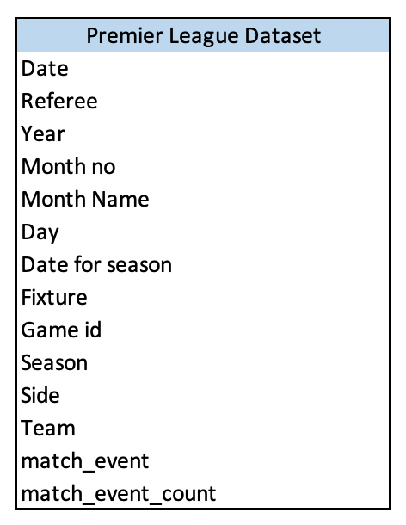
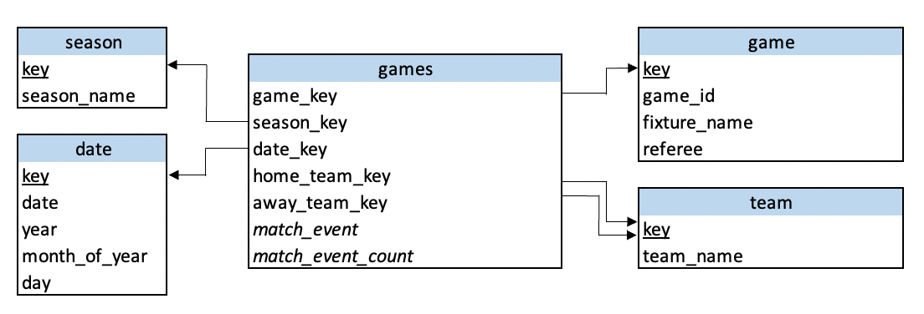
DIMENSIONAL MODELLING
FROM THIS
TO THIS

Slide 8
ASK 3 : DATA ANALYSIS
BUSINESS QUESTION 1:
What is the best performing team with highest score across the seasons between 2007|2008 and 2017|2018? What strategy earns more points-'Attack’ vs ‘Defense’ attributes. ?
Part1: Best performing team with highest score across the seasons between 2007|2008 and 2017|2018.
Part2: Test our hypothesis in the seasons 2017/2018, 2015/2016, and
2011/2012 to find out any correlation with higher points and
other attributes which results in the best strategy (Attack vs Defense ).

Slide 9
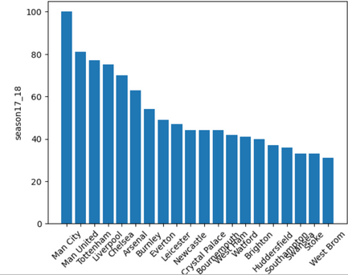
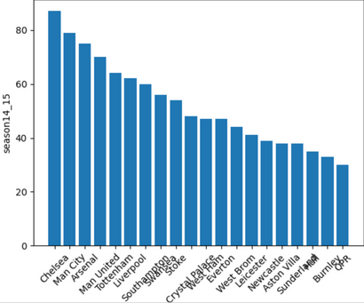
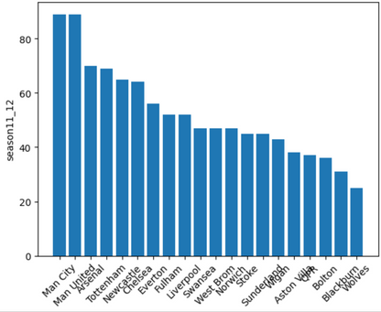
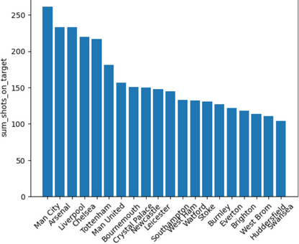
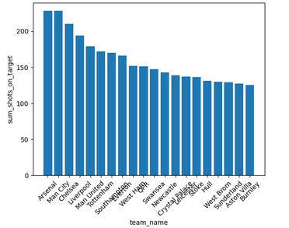
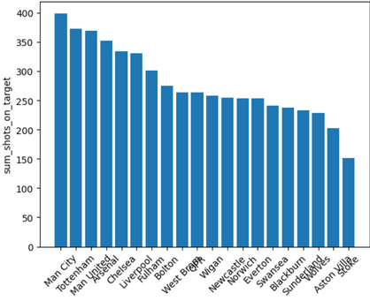
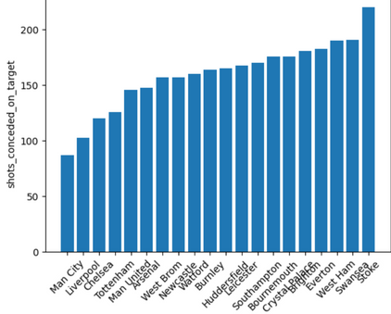
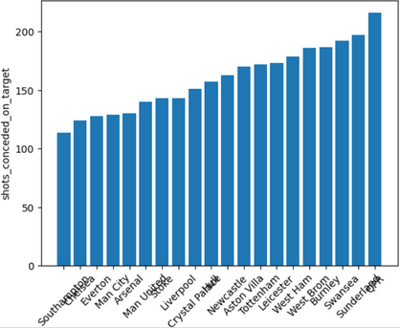
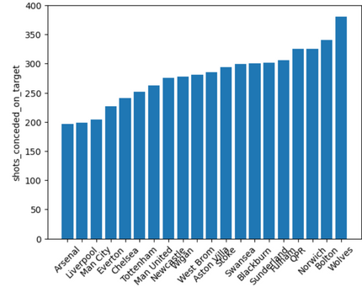
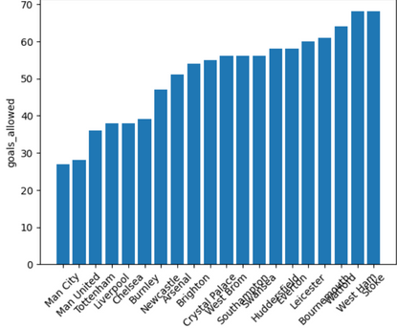
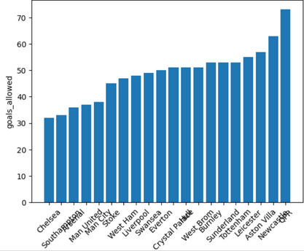
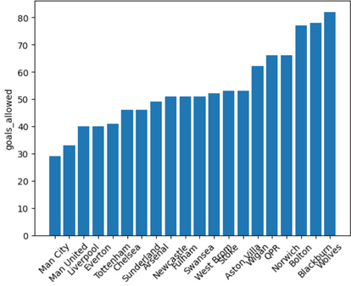
Season 2017-18
Season 2014-15
Season 2011-12
Team Score Points
Total Shots on Target
Total Conceded Shots
Goals Allowed
Presentation by
Timmerman University | 2023

Slide 10


FINDINGS
The best performing team in the past 10 years since 2018 is Man United, as they have accumulated 870 points, followed by Chelsea then Man City.
During 2014-15 season, team Chelsea which finished on the top with highest score didn't have the most shots on target. Here, the preliminary analysis is holding up! The better you defend, the higher your chances to finish at the top.
01
04
During 2017-18 season, team Man City scored more shots on targets and also secured the highest points in the season. But team Man United ranks 6th in terms of 'shots on target' but secures second highest position in this season. So there exists a correlation with other attributes such as shots conceded that results to the high score.
02
In conclusion, after conducting the analysis on the 2011-12 season, the data shows that defense is the decisive factor in finishing the season with the high points. However, while the data also shows that defense is the most crucial factor, but to finish in the top, you also have to perform highly on the attack.
05
After running multiple analytical queries on the 2017-18 season, it is observed that while attacking is important to secure the highest score, defense strategy is also a decisive factor. The better teams to defend, the better their chances of finishing at the top.
03

Slide 11
BUSINESS QUESTION 2:
This part is intended to help coaches and players be cautious of
certain referees.
Who is the strictest referee that issued the most yellow and red cards during 2015-2018, that we need to be aware of? Over time, what’s the trend of red cards and yellow cards issued?
Part1: Who is the strict referee that issued more yellow and red cards during 2015-2018, that we need to be aware of?
Part2: Count from 2001 to 2018, the total red cards and yellow cards issued each year. See whether there’s a trend
Notes:
This part is intended to help coaches and players be cautious of certain referees and so manage the performance better
For the specific question we are interested to know who’s the strict referee issue more cards
Next, we want to identify the trend of cards issue over time

Slide 12
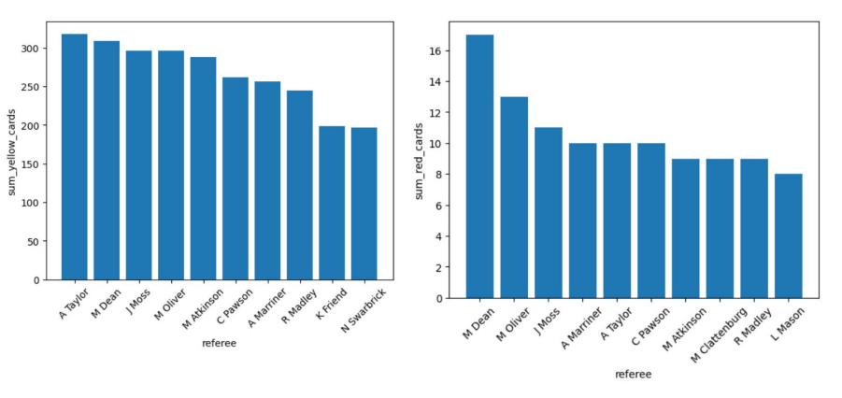
Business question 2. Part-1
Notes:
In terms of yellow card isuued
Talyor issued the most yellow cards than peers
Followed by Dean Moss
However, in the red card issued
Dean issued relatively more red cards than the others.

Slide 13
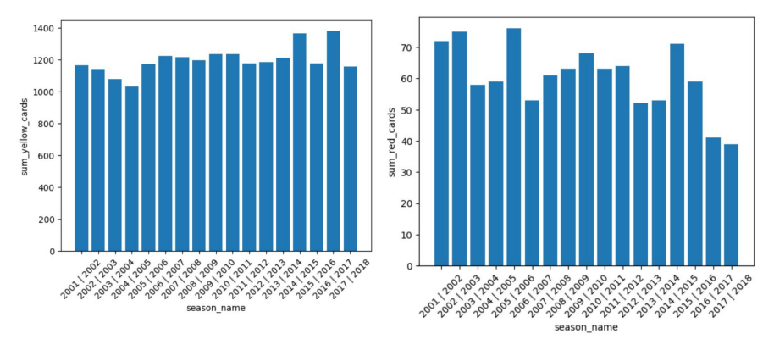
Business question 2. Part-2
Notes:
This part, we wan to identify the trend of yellow cards & issued over time.
Focusing on the yellow card, it seems not so much a clear trend:
At first, it decreased a bit but increase to around 1200 to stay relatively consistent.
For the red cards issued, it seems to be a decreasing trend.
Only a few outlier in the specific year, such as season 02, 04, and 14.

Slide 14
FINDINGS
PART 1
PART 2
In terms of the yellow card issued, A Taylor issued more than other referees (318). Following, M Dean is the second the J Moss is the third.
It seems that yellow cards issued aren’t related with time. However, as time goes by, red cards issued have a decreasing trend.
01
05
With the insight, coaches can focus on red cards management.
In terms of the red card issued, M Dean issued more than other referees (17). Following, M Oliver is the second the J Moss is the third.
06
02
Consider both yellow and red cards issues, the top 5 strict referees are M Dean, M Oliver, J Moss, A Taylor, and C Pawson.
03
04
When playing against them, players need to be careful and avoid the disadvantages.
Notes:
Conclude of these analysis
Taylor issued the most yellow card and Dean issued the most red cards.
Consider two cards: Dean Issued the most fellowed by Oliver and Moss
When dealing with these referees, players and coaches need to be cautious.
For the second part, it seems that no clear trend in the yellow card but a decreasing trend in the red card,
Thus coaches can put more efforts to the red card management and avoid disadvantage.

Slide 15
BUSINESS QUESTION 3:
What is the total points of each team across 21 seasons? How does the corner kick effect the team’s total points? What is the relationship between these attributes?

Slide 16
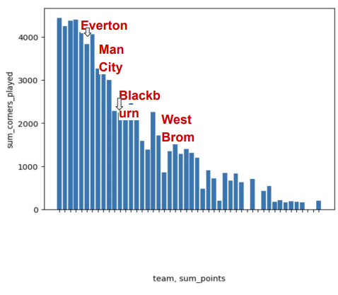
FINDINGS
From the bar chart, we can see in general the more corners played, the more points earned across the 20 seasons. However we can see that some teams did not benefit from this correlation in the way that the majority did.
01
For example, West Brom had 2255 corners played across the 21 seasons but only earned 464 points from games in this time period. To compare, Blackburn had a similar number of corners played, 2242, but earned 623 points.
02
We can also look at Man City who had 4065 corners played, the 6th most out of all teams, and earned 1082 points, 7th most. Everton, on the other hand, had 3831 corners played, less than Man City, and 1123 total points secured, more than City overall.
03
We would like to conduct similar analysis but focusing on the disadvantage of conceding corners and what effect this has on points earned. We will select all 21 seasons.
04

Slide 17
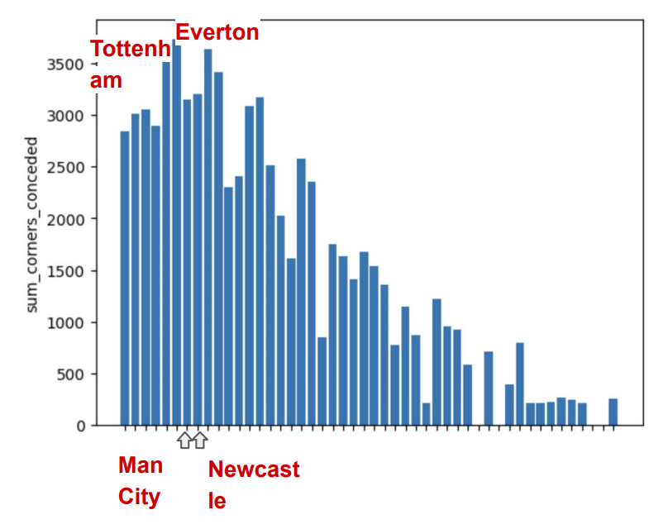
FINDINGS
To know the team that had disadvantage from the corner kick, we choose and analyze total points across the 20 seasons and corner conceded.
01
From the bar chart, interestingly, we can see the 4 teams with the highest total points, had lower corners conceded than other teams such as Tottenham and Everton.
02
We were expecting to see more corners conceded for teams with lower points but it is important to note that these teams with few points played fewer games overall and this has a big effect on how the correlation looks on the visualization.
03

Slide 18
BUSINESS QUESTION 4:
Which team had received the highest number of yellow cards during the season 2017-2018 and under which referee did they receive them from? From this, we can advise certain teams to play more conservatively in future games when they are assigned these referees.

Slide 19


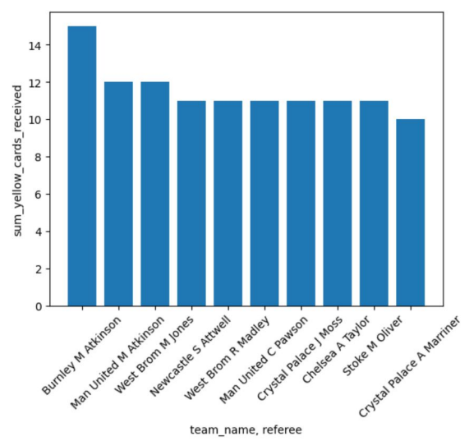

FINDINGS
Following these results from the bar graph, we would highly encourage Burnley to play more conservatively and encourage their players not to make strong tackles in games where Martin Atkinson is the referee in the future.
01
We also recommend that Man United spend additional time on defensive tackling drills since they appeared twice in the top ten teams to receive yellow cards from the same referee, with Martin Atkinson handing out 15 yellow cards to them and Craig Pawson handing them 11 yellow cards.
02
In this same season, Man United finished with 81 points which was 19 fewer than the league champions Man City, who finished with 100 points.
03
Man City did not appear in this table at all so we would argue that these yellow cards may have an influence on points earned overall.
04

Slide 20




QUESTION TIME
THANK YOU!!!

